Slide 1
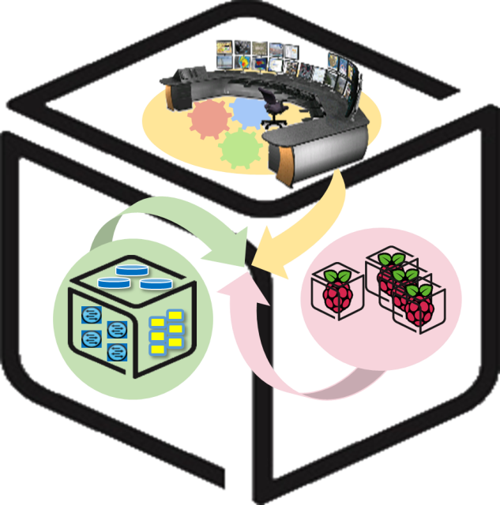
SmartX Labs for Computer Systems
Functions Lab v1.4
(2018, Spring)
NetCS Lab

Slide 2
History and Contributor of Functions Lab
(2016. 06. 01)
Version | Updated Date | Updated Contents | Contributor
v1.0 | 20160517 | 초고 완성 | 배 정 주
v1.1 | 20160601 | p20, p32 wordpress url을 yourip -> localhost로 변경 (헷갈림 방지) | 배 정 주
v1.2 | 20170510 | Docker image 버전 업데이트 및 스크린샷 수정 | 권 진 철
V1.3 | 20180124 | Container 내부 업데이트 및 iputils-ping패키지 다운 | 이 승 형
V1.4 | 20180522 | Kubernetes 실습 추가 | 권 진 철

Slide 3
Functions Lab: Goal
Strength of Docker: Docker Image
Introduce Docker Hub + Searching and Getting Image from Docker Hub
Running 3 Tier (nginx-wordpress-mysql) Web Application
Understanding Docker basic network (--link option)

Slide 4
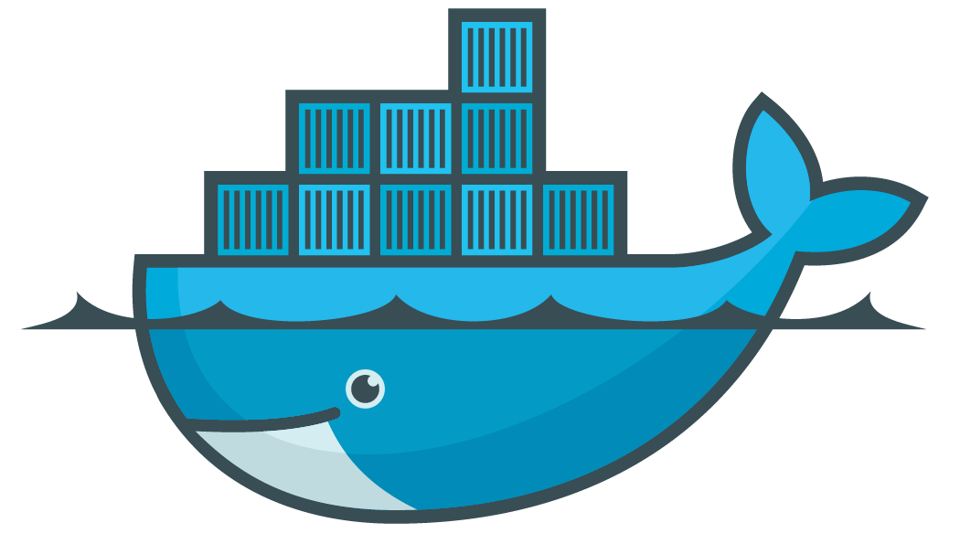





Functions Lab: Overall - One of 3-Tier example
Docker Hub

Slide 5
Functions Lab: Overall - Background knowledge of goal
We will running one of web application: Wordpress
This web application is consisted with 3 containers: nginx, wordpress, mysql
nginx
: A http server which has following features.
- Reverse proxying
- SSL TLS SNI support… and etc
Usually, It is compared by Apache.
wordpress
: It is web software to create website, blog, or application.
mysql
: Relational Database Management System(RDBMS)

Slide 6
Functions Lab: Overall - Scenario
Request:
ipaddress:8888
port: 8888
Request:
ipaddress[:80]/red
port: 9999
Request:
ipaddress[:80]/black
port: 8888

Slide 7
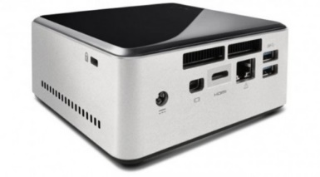
Prerequisite for Functions lab
Functions lab focus on (Docker container) functions of NUC
docker-engine (version: 1.10 or above)

Slide 8
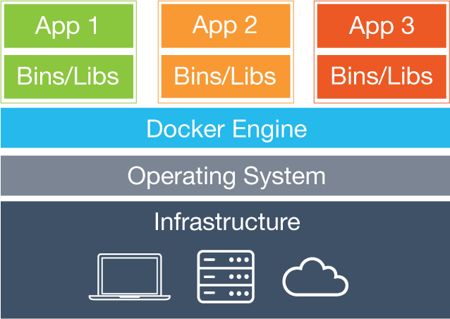
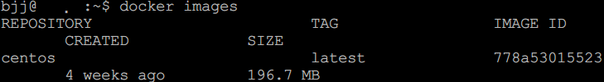
Docker Background Knowledge
- Reminder: Docker Image
Docker image: A file which contains status of Docker container.
Similar to snapshot of VM.
It can be branched and versioned…
Docker image can be shared easily.
(It is important feature of Docker.)
You can find Ubuntu image on your machine

Slide 9
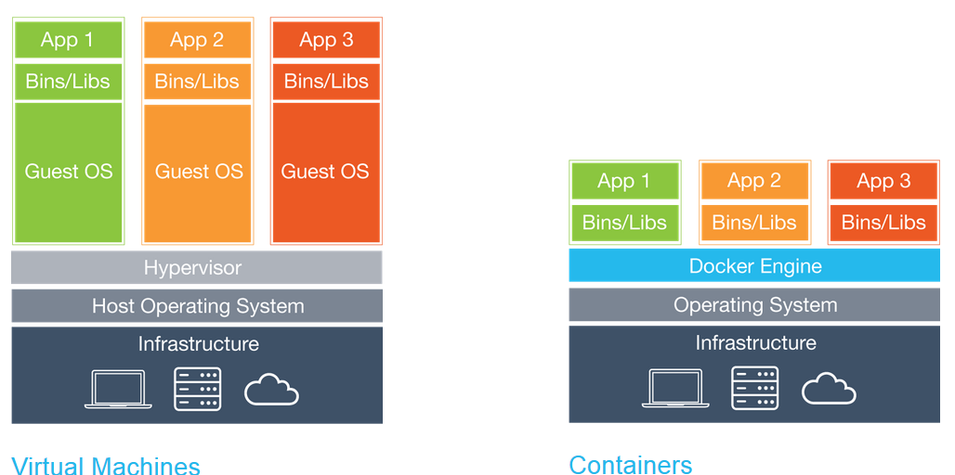
Docker Background Knowledge
- Reminder: Container restraint
Since container uses host kernel, OS of host should be Linux distribution.

Slide 10
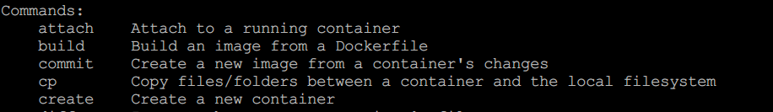
Docker Background Knowledge
- Why Docker image can be shared easily? (1)
Docker provides related commands!
This usage is similar to code management system. (e.g, svn, git)

Slide 11
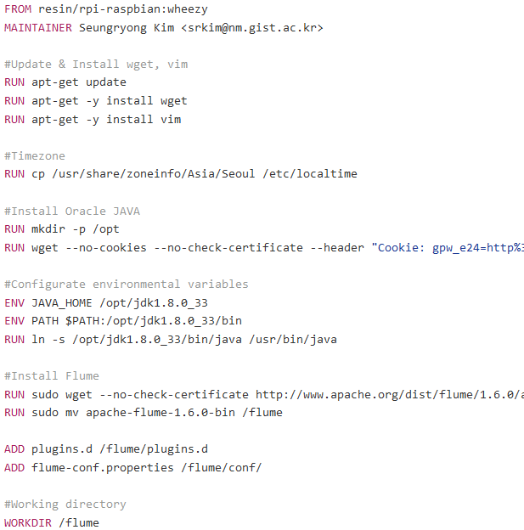
Docker Background Knowledge
- Why Docker image can be shared easily? (2)
Docker image is built by Dockerfile which is small text file.
That means sharing Docker image does not requires huge bandwidth (sometimes).

Slide 12
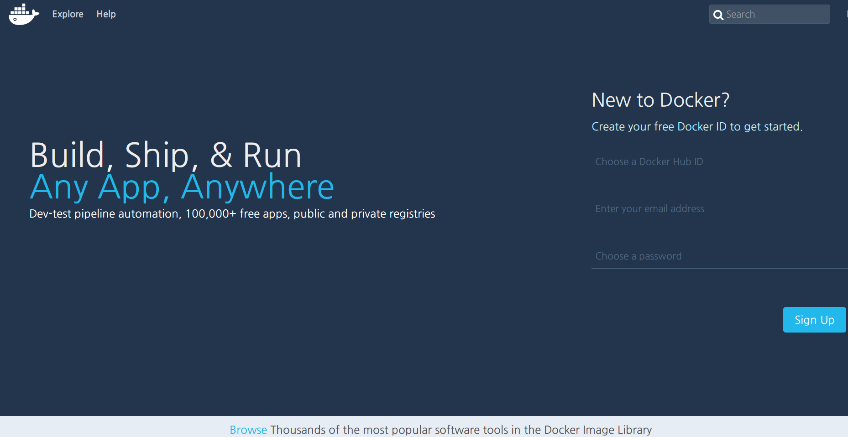
Getting Docker Image
- Public Docker Image Repository: Docker Hub (1)
https://hub.docker.com/

Slide 13

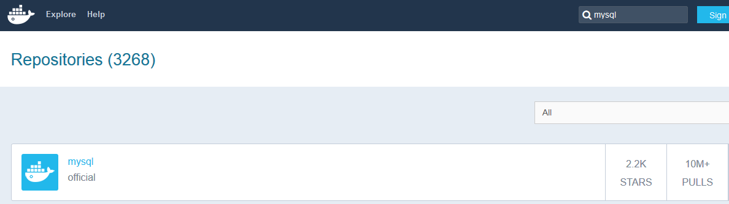
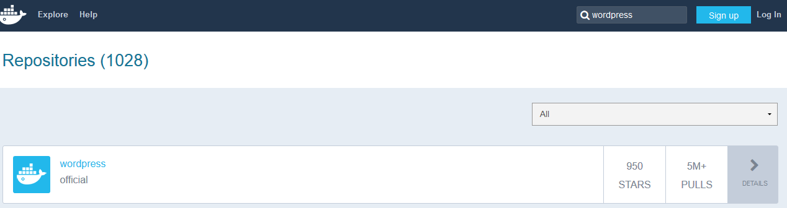
Getting Docker Image
- Public Docker Image Repository: Docker Hub (2)
You can easily find application image

Slide 14
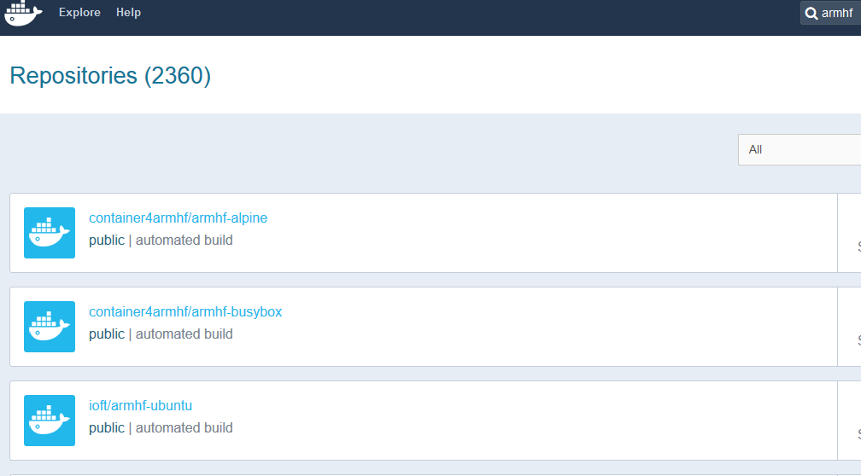
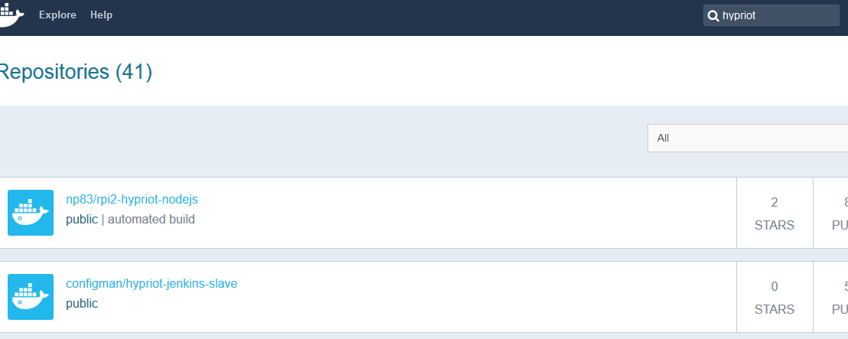
Getting Docker Image
- Be aware!
x86 based image can not run in Raspberry Pi!
If you want to use Docker image in RPi, you should find ARM based image!

Slide 15
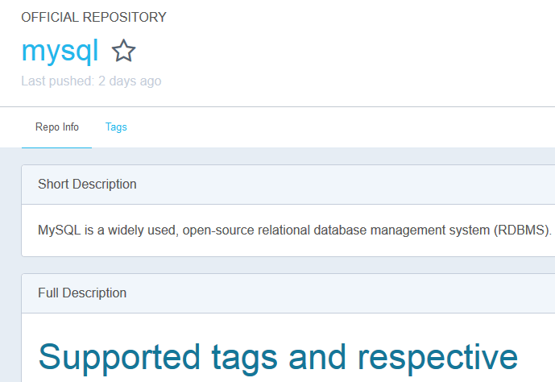

Getting Docker Image
- Public Docker Image Repository: Docker Hub (3)
Before using Docker image, you should read description.
It is very important because required option rely on image.

Slide 16
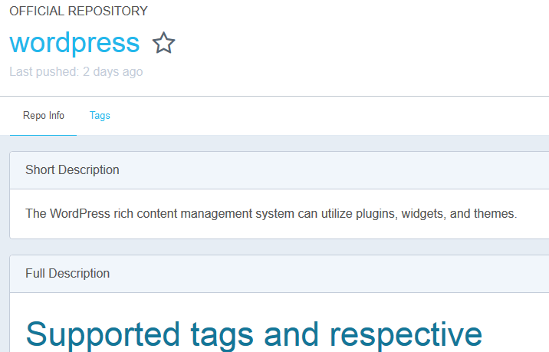
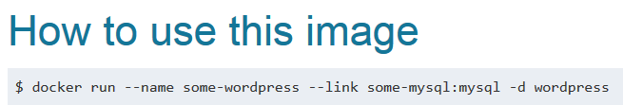
Getting Docker Image
- Public Docker Image Repository: Docker Hub (4)

Slide 17
Functions Lab: - Try: wordpress-mysql
Request:
ipaddress:8888
port: 8888
Request:
ipaddress[:80]/red
port: 9999
Request:
ipaddress[:80]/black
port: 8888

Slide 18
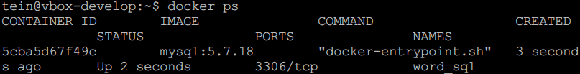
Running Web Application - Run mysql container
mkdir ~/sql
sudo docker run --name word_sql -v /home/[username]/sql:/var/lib/mysql -e MYSQL_ROOT_PASSWORD=[password] -d mysql:5.7.18
Tag. Default is latest (Latest version)
sudo docker ps

Slide 19
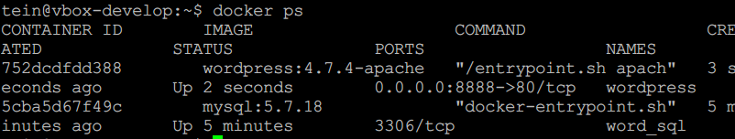
Running Web Application - Run wordpress container
sudo docker run --name wordpress --link word_sql:mysql -p 8888:80 –d wordpress:4.7.4-apache
(Will be introduced)
sudo docker ps

Slide 20
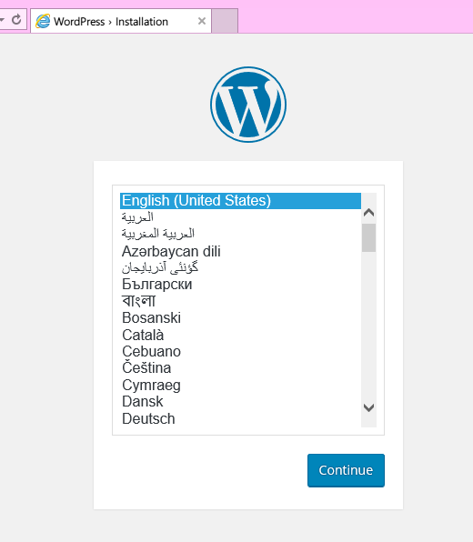
Running Web Application - Check wordpress!
http://localhost:8888
We typed just 2 line of commands
to running wordpress!
This is one of major Docker strength
:Easy deployment of software

Slide 21
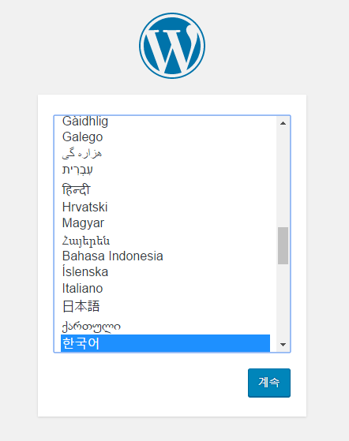
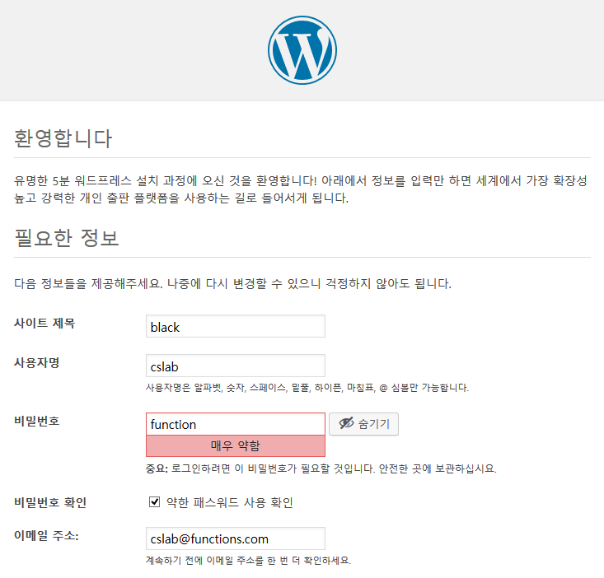

Running Web Application
- Default configuration: Wordpress

Slide 22
Running Web Application
- About --link option (1)
(In official docs..)
Docker also has a linking system that allows you to link multiple containers together and send connection information from one to another. When containers are linked, information about a source container can be sent to a recipient container. This allows the recipient to see selected data describing aspects of the source container.
Links allow containers to discover each other and securely transfer information about one container to another container. When you set up a link, you create a conduit between a source container and a recipient container.
Usage: --link <name or id>:alias
--link <name or id>
Naming container is important!

Slide 23
Running Web Application
- About --link option (2)
sudo docker inspect -f "{{ .HostConfig.Links }}" wordpress
You can see wordpress container is linked with mysql container.
Conduit which is made by --link option

Slide 24
Running Web Application
- About --link option (3)
(In official docs..)
Docker creates a secure tunnel between the containers that doesn’t need to expose any ports externally on the container.
That’s a big benefit of linking: we don’t need to expose the source container.
Review our commands: Creating mysql container
→ This container doesn’t expose any ports.
mkdir sql
sudo docker run --name word_sql -v /home/[username]/sql:/var/lib/mysql -e MYSQL_ROOT_PASSWORD=[password] -d mysql
Also we don’t need to type password of mysql when creating wordpress container
sudo docker run --name wordpress --link word_sql:mysql -p 80:80 -d wordpress

Slide 25
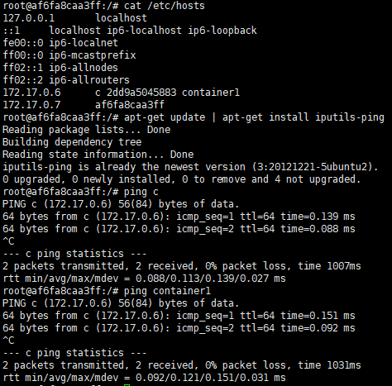

Running Web Application
- About --link option (4)
(In official docs..)
Functionality of this option is:
- Updating Environment variables
- Updating the /etc/hosts file

Slide 26
Functions Lab: - Try: nginx-wordpress-mysql
Request:
ipaddress:8888
port: 8888
Request:
ipaddress[:80]/red
port: 9999
Request:
ipaddress[:80]/black
port: 8888

Slide 27
Running Web Application
- Make another wordpress container set
Request:
ipaddress[:80]/red
port: 9999
Request:
ipaddress[:80]/black
port: 8888
mkdir ~/sql2
sudo docker run --name word_sql2 -v /home/[username]/sql2:/var/lib/mysql -e MYSQL_ROOT_PASSWORD=[password] -d mysql:5.7.18
sudo docker run --name wordpress2 --link word_sql2:mysql -p 9999:80 -d wordpress:4.7.4-apache

Slide 28
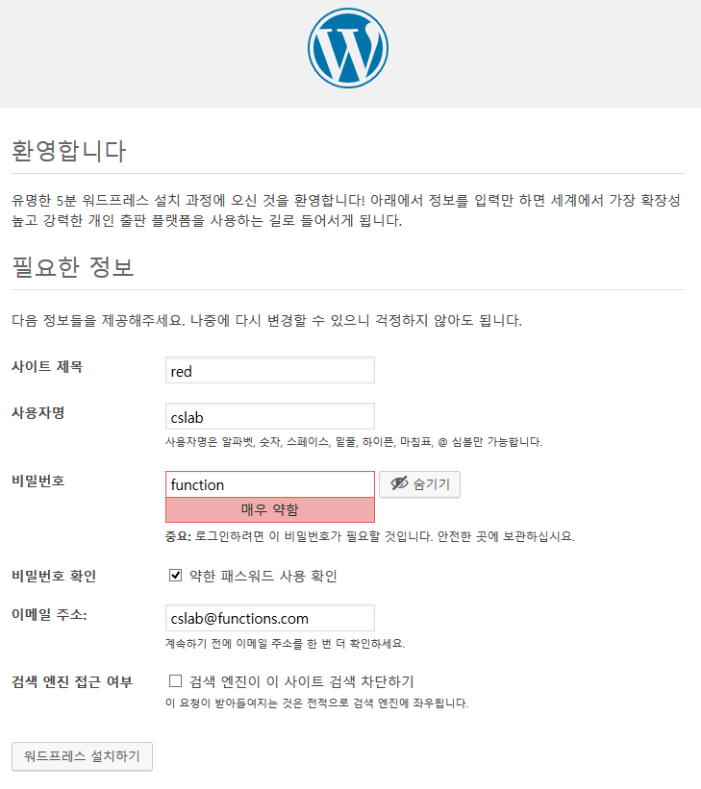

Running Web Application
- Default configuration: Wordpress

Slide 29
Running Web Application
- Current status
ip:8888
ip:9999

Slide 30
Running Web Application
- Make container for reverse proxy
sudo docker run -it --name=nginx -p 80:80 ubuntu:16.04
Forwarding host_port:container_port

Slide 31
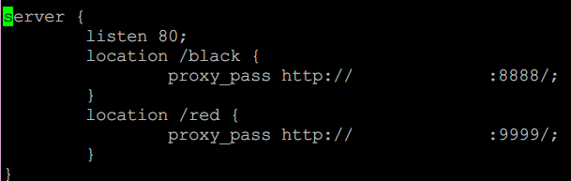
Running Web Application
- Setting reverse proxy
sudo apt-get update
sudo apt-get install nginx
sudo apt-get install vim
cd /etc/nginx/sites-enabled
rm default
vi default
[your ip]
[your ip]
service nginx start

Slide 32
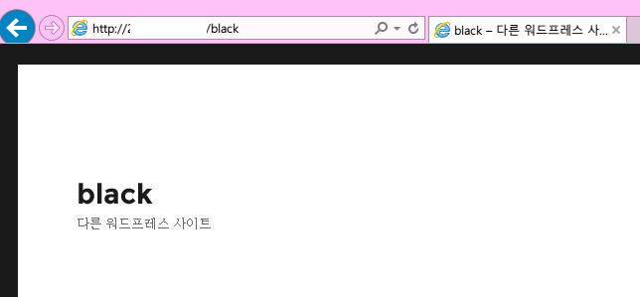
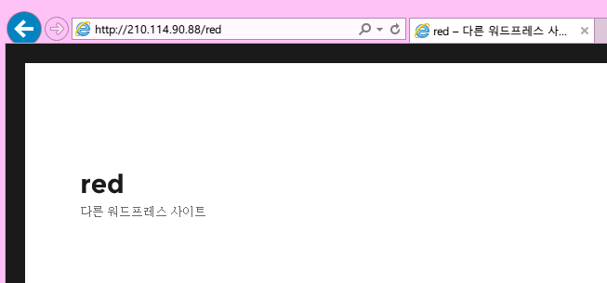
Running Web Application
- Setting reverse proxy
Try
http://localhost/black
http://localhost/red

Slide 33
Running Web Application
- Setting reverse proxy
Try
http://localhost/black
http://localhost/red

Slide 34
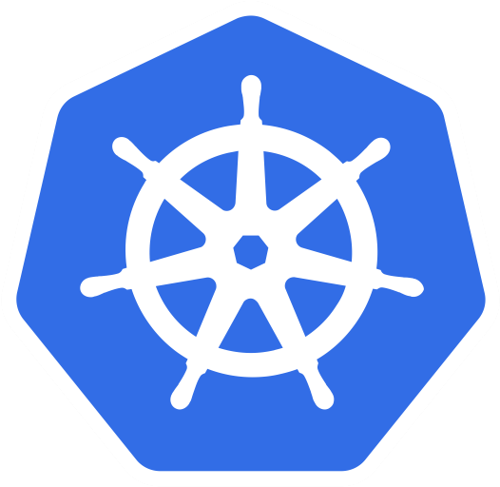
Running Web Application
- About Kubernetes (1)
Kubernetes is an open-source system for automating deployment, scaling, and management of containerized applications.
Kubernetes Features
Horizontal scaling: Scale your application up and down with a simple command, with a UI, or automatically based on CPU usage.
Self-healing: Restarts containers that fail, replaces and reschedules containers when nodes die, kills containers that don't respond to your user-defined health check, and doesn't advertise them to clients until they are ready to serve.
Service discovery and load balancing: No need to modify your application to use an unfamiliar service discovery mechanism. Kubernetes gives containers their own IP addresses and a single DNS name for a set of containers, and can load-balance across them.
Storage Orchestration: Automatically mount the storage system of your choice, whether from local storage, a public cloud provider
https://kubernetes.io/

Slide 35
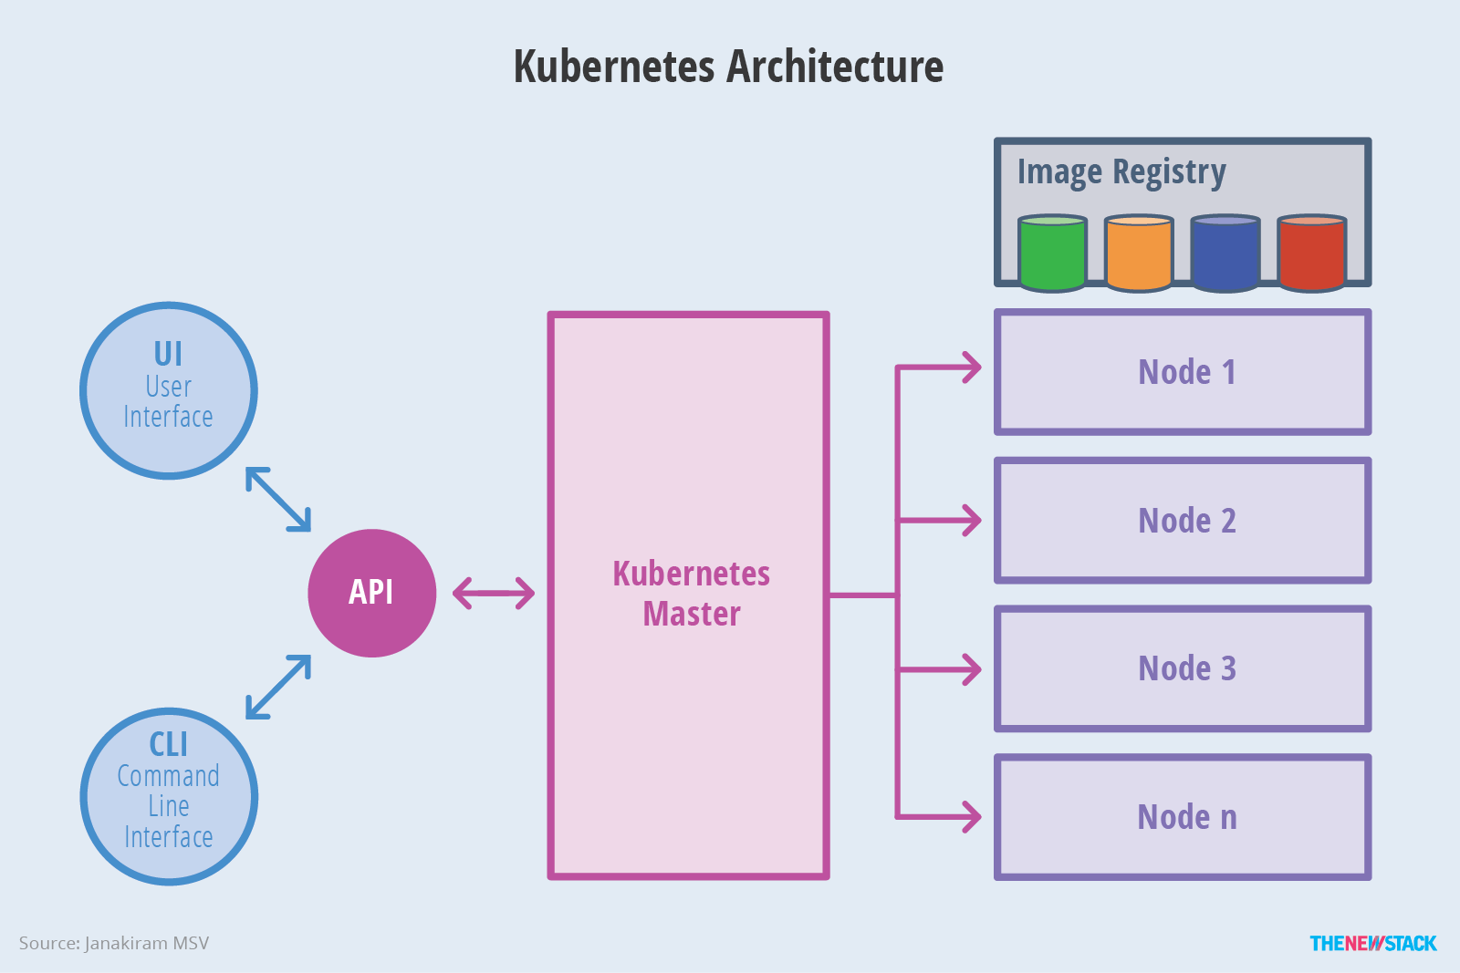
Running Web Application
- About Kubernetes (2)
Master
Compute nodes
Kubernetes cluster consists of at least one master and multiple compute nodes.
Computing Cluster is a form of computing in which a group of computers are linked together so that they can act like a single entity
→ You will be learn more in the next lab.

Slide 36
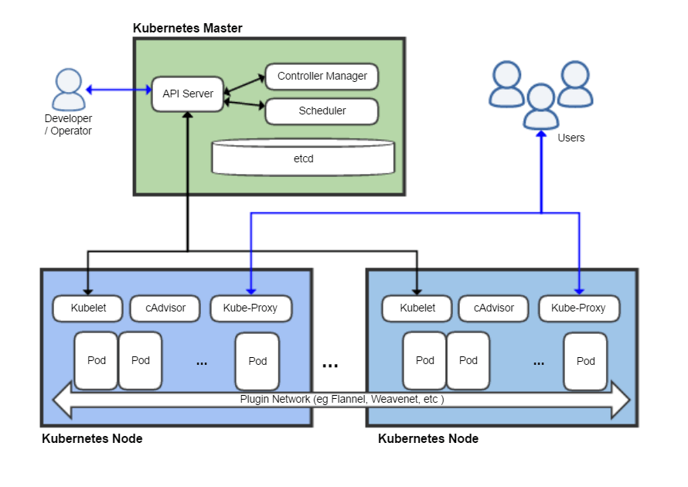
Running Web Application
- About Kubernetes (3)
The master is responsible for exposing the application program interface (API), scheduling the deployments and managing the overall cluster.
Pod is consists of one or more containers that are guaranteed to be co-located on the host machine and can share resources. Each pod is assigned a unique IP address within the cluster, which allows applications to use ports without the risk of conflict.

Slide 37
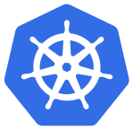
Running Web Application
- Make a worpress container set With Kubernetes
Request:
ipaddress[:30080]
Kube-proxy
[:80]
Install kubernetes
sudo su
apt-get update && apt-get install -y apt-transport-https curl
curl -s https://packages.cloud.google.com/apt/doc/apt-key.gpg | apt-key add -
cat <<EOF >/etc/apt/sources.list.d/kubernetes.list
>deb http://apt.kubernetes.io/ kubernetes-xenial main
>EOF
apt-get update
apt-get install -y kubelet kubeadm kubectl

Slide 38
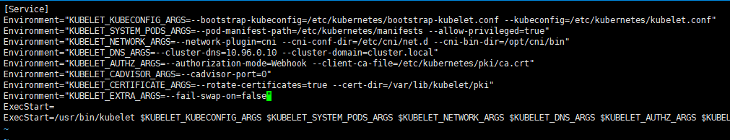
Running Web Application
- Configure Kubernetes (1)
Edit kubernetes configure file
sudo vi /etc/systemd/system/kubelet.service.d/10-kubeadm.conf
Add [ Environment=“KUBELET_EXTRA_ARGS=--fail-swap-on=false” ]
sudo systemctl daemon-reload
sudo systemctl restart kubelet
Add the line like this
Run a kubernetes cluster: Your NUC will be a Worker node as well as a Master.
sudo kubeadm reset
kubeadm init --skip-preflight-checks

Slide 39

Running Web Application
- Configure Kubernetes (2)
Run these commands to make kubectl work for your non-root user.
Make sure that you are not in root
mkdir -p $HOME/.kube
sudo cp -i /etc/kubernetes/admin.conf $HOME/.kube/config
sudo chown $(id -u):$(id -g) $HOME/.kube/config
Check your cluster status
sudo kubectl get nodes
Your NUC is running as a kubenetes master.
But pods are not allowed to be scheduled to run on the master
It allows pods to be scheduled to run on the Kubernetes master server
kubectl taint nodes --all node-role.kubernetes.io/master-

Slide 40

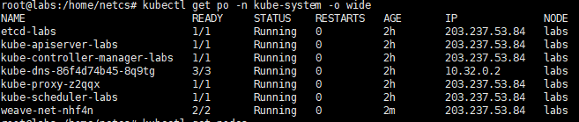
Running Web Application
- Configure Kubernetes (3)
You MUST install a pod network add-on so that your pods can communicate with each other. We will use Weave in this lab.
Install Weave (pod network add-on)
kubectl apply -f "https://cloud.weave.works/k8s/net?k8s-version=$(kubectl version | base64 | tr -d '\n')"
Make sure Weave(network add-on) works
sudo kubectl get nodes
kubectl get po -n kube-system -o wide

Slide 41
Running Web Application
- Run Wordpress application (1)
We will run Wordpress application using kubernetes template which describes how to run wordpress and sql container.
Get the yaml template
wget -O wordpress.yaml https://mirror.nm.gist.ac.kr/getWordpress
Using the template, deploy containers(pods) to run wordpress application
kubectl create secret generic mysql-pass --from-literal=password=YOUR PASSWORD
kubectl apply -f wordpress.yaml
Check the pods are running well (About 1 minute later)
kubectl get svc –o wide

Slide 42
Running Web Application
- Run Wordpress application (2)
Try
http://your NUC IP:30080

Slide 43
Appendix
Control Tower: Docker Private Registry

Slide 44
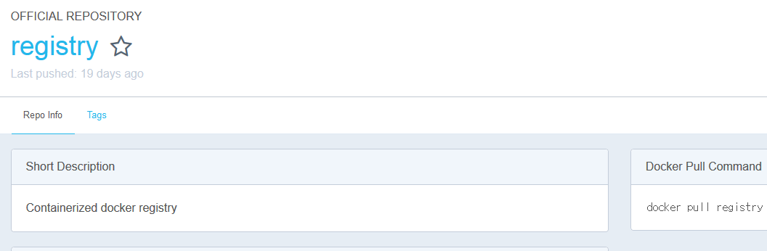
Docker Private Registry
- About
In previous slides, Docker image is operated and maintained likes source code (e.g svn, git…)
Also we used Docker public repository, Docker Hub. (which looks like github)
Surely, Docker also provides private repository: Registry.

Slide 45
Docker Private Registry
- How to use (1)
Deployment(In control tower):
docker run -d -p 5000:5000 --restart=always --name registry registry:2
--restart=always means this container is already running even Docker host rebooted.

Slide 46
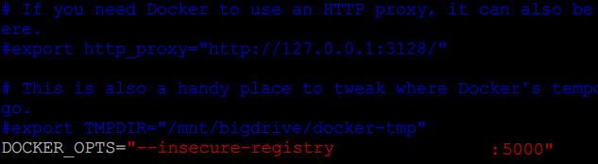
Docker Private Registry
- How to use (2)
You may configure insecure-registry options on NUC and Raspberry Pi
(Basic registry runs on insecure mode.)
Setting(In NUC and RPi):
sudo vi /etc/default/docker
DOCKER_OPTS=“--insecure-registry [control tower ip]:5000”
If any DOCKER_OPTS is already been, just add this phrase to end of OPTS.
sudo service docker restart

Slide 47
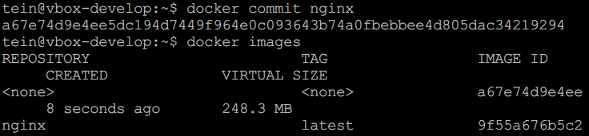
Docker Private Registry
- How to push and pull image (1)
In this time, we make a image of nginx container and push to registry
Making container image and push to registry (In NUC):
docker commit nginx
docker images

Slide 48
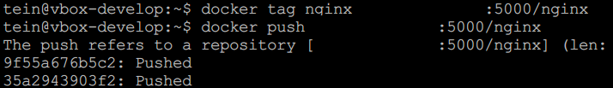

Docker Private Registry
- How to push and pull image (2)
Tagging image for pushing and push image
docker tag nginx [control tower ip]:5000/nginx
docker push [control tower ip]:5000/nginx
Check!
curl [control tower ip]:5000/v2/_catalog
You can find!

Slide 49
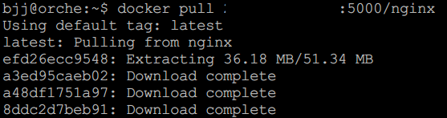
Docker Private Registry
- How to push and pull image (3)
Pulling(In other machines):
docker pull [control tower ip]:5000/nginx

Slide 50
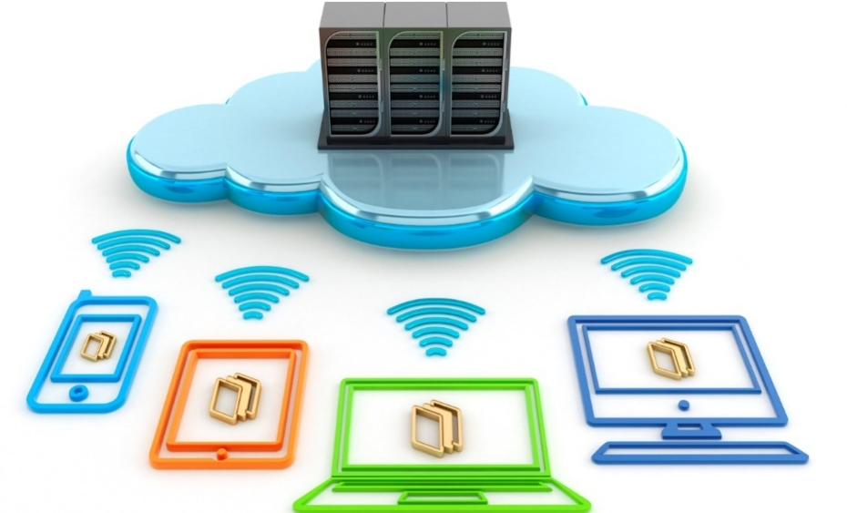
Thank You for
Your Attention
Any Questions?

